Slide 1
Antimicrobial susceptibility testing

Slide 2
Drug-resistant bacteria have given rise to several serious outbreaks of infection, with many deaths.

Slide 3
This has led to a need for national and international surveillance programmes to monitor antibiotic resistance in bacteria by susceptibility testing using reliable methods that generate comparable data.
The availability of microbiological and epidemiological information would help clinicians in selecting the most appropriate antimicrobial agent for the treatment of a microbial infection

Slide 4
The susceptibility test must be performed by an accurate and reproducible method, the results of which should be directly applicable to the clinical situation.
The ultimate criterion of the reliability of any susceptibility testing method is its correlation with the response of the patient to antimicrobial therapy.

Slide 5
Kirby-Bauer method
WHO in I976 considered the modified disc technique of Kirby-Bauer.
For the following purposes
1. Clinical
2. Surveillance
Reasons
1. Its technical simple
2. It is reproducible

Slide 6
The method is particularly suitable for use with bacteria belonging to the family Enterobacteriaceae
but it can also be recommended as a general purpose method for all rapidly growing pathogens, except strict anaerobes.
It was therefore recommended that the details of the K-B test method be made available for laboratory workers.

Slide 7
General principles of antimicrobial susceptibility testing
Antimicrobial susceptibility tests measure the ability of an antibiotic or other antimicrobial agent to inhibit bacterial growth in vitro.
This ability may be estimated by either the
1. dilution method or
2. the diffusion method

Slide 8
Dilution method
This is for quantitative estimates of antibiotic activity.
Dilutions of the antibiotic may be incorporated into broth or agar medium, then inoculated with the test organism. Incubated overnight.
The lowest concentration that prevents growth after overnight incubation is known as the minimum inhibitory concentration (MIC) of the agent.

Slide 9
Application of the MIC
The MIC value obtained is then compared with known concentrations of the drug obtainable in the serum and in other body fluids to assess the likely clinical response.

Slide 10
The diffusion test
Paper discs are impregnated with an antibiotic.
An agar medium is seeded uniformly with test organism.
The impregnated disc with the antibiotic, is placed on the seeded agar medium with the test organism.

Slide 11
The antibiotic in the disc difuses into the medium.
A concentration gradient of the antibiotic forms by diffusion from the disc. The growth of the test organism is inhibited at a distance from the disc. This zone of inhibition is related, to the susceptibility of the organism (among other factors).

Slide 12
Relationship between dilution and disc diffusion
There is an approximately linear relation between log MIC, as measured by a dilution test, and the inhibition zone diameter in the diffusion test.
A regression line expressing this relation can be obtained by testing a large number of strains by the two methods in parallel.

Slide 13
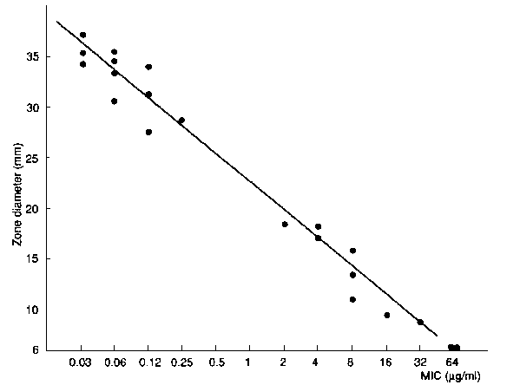
Graphic representation of the relationship between log₂MIC and the inhibition zone diameter obtained by the diffusion test using discs containing a single concentration of antibiotic

Slide 14
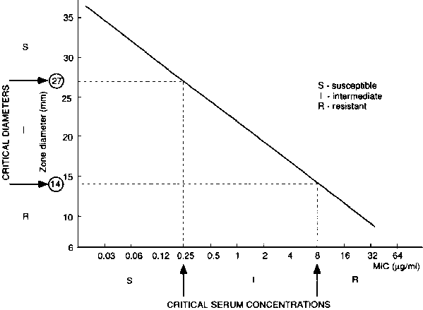
Interpretation of zone sizes as susceptible, intermediate, and resistant by their relationship to the MIC

Slide 15
Interpretation of susceptibility test results
Two category system—
A--- susceptible
B--- Resistant
Three category system—
1. Susceptible
2. Intermediate susceptible
3. Resistant.

Slide 16
Two category system
Susceptible
An organism is called “susceptible” to a drug when the infection it has caused is likely to respond to treatment with this drug, at the recommended dosage.
Resistant.
The organism is expected not to respond to a given drug, irrespective of the dosage and (also irrespective) of the location of the infection.

Slide 17
Three category system
Here in addition to susceptible and resistant
there is also “intermediate susceptible”.

Slide 18
Meaning of the intermediate susceptible
Intermediate susceptibility covers two situations. It is applicable to strains that are “moderately susceptible” to an antibiotic that can be used for treatment at a higher dosage because of its low toxicity or because the antibiotic is concentrated in the focus of infection (e.g., urine).
The classification also applies to strains that show “intermediate susceptibility” to a more toxic antibiotic that cannot be used at a higher dosage. In this situation, the intermediate category serves as a buffer zone between susceptible and resistant.

Slide 19
Other factors to consider to select a drug by a physician
1. Pathogenic significance of the microorganism
2. Side-effects and pharmacokinetic properties of the drug,
3. diffusion in different body sites and
4. the immune status of the host.
The above factors are considered.

Slide 20
Indications for routine susceptibility tests
A susceptibility test may be performed in the clinical laboratory for two main purposes:
• to guide the clinician in selecting the best antimicrobial agent for an individual patient.
• to accumulate epidemiological information on the resistance of microorganisms of public health importance within the community.

Slide 21
Susceptibility tests as a guide for treatment
Susceptibility tests should never be performed on contaminants or commensals belonging to the normal flora, or on other organisms that have no causal relationship to the infectious process.
For example, the presence of Escherichia coli in the urine in less than significant numbers is not to be regarded as causing infection, and it would be useless and even misleading to perform an antibiogram.

Slide 22
Susceptibility tests as an epidemiological tool
Routine susceptibility tests on major pathogens (S. typhi, shigellae) are useful as part of a comprehensive programme of surveillance of enteric infections.
They are essential for informing the physician of the emergence of resistant strains (chloramphenicol-resistant S. typhi, co-trimoxazole-resistant and ampicillin-resistant shigellae) and of the need to modify standard treatment schemes.

Slide 23
Choice of drugs for routine susceptibility tests in the clinical laboratory
Antibiotic choice is governed by
1. antibacterial spectrum of the drugs
2. the pharmacokinetic properties of the drug
3. toxicity
4. efficacy
5. availability
6. the cost to both the patient (and the community).
In Ghana select from the essential drug list of the NHIS.

Slide 24
 | Staphylococcus | Enterobacteriaceae |  |  | Pseudomonas aeruginosa
 |  | Intestinal | Urinary | Blood and tissues
Set 1 First choice | benzylpenicillin oxacillin erythromycin tetracycline chloramphenicol | ampicillin chloramphenicol co-trimoxazole nalidixic acid tetracycline | sulfonamide trimethoprim co-trimoxazole ampicillin nitrofurantoin nalidixic acid tetracycline | ampicillin chloramphenicol co-trimoxazole tetracycline cefalotin gentamicin | piperacillin gentamicin tobramycin
Set 2 Additional drugs | gentamicin amikacin co-trimoxazole clindamycin | norfloxacin | norfloxacin chloramphenicol gentamicin | cefuroxime ceftriaxone ciprofloxacin piperacillin amikacin | amikacin

Slide 25
The benzylpenicillin disc is used to test susceptibility to all β-lactamase-sensitive penicillins (such as oral phenoxymethylpenicillin and pheneticillin).
Isolates of staphylococci that are resistant, produce β-lactamase, so should be treated with a β-lactamase-resistant penicillin or with another antibiotic, such as erythromycin.

Slide 26
Oxacillin
The oxacillin disc is representative of the whole group of β-lactamase-resistant penicillins (including meticillin, nafcillin, cloxacillin, dicloxacillin, and flucloxacillin).
There is good clinical evidence that cross-resistance exists between the methicillin and the cephalosporin groups.
Note: Resistance to methicillin and related drugs is often of the ‘heterogeneous type’.

Slide 27
Tetracycline
The results for the tetracycline disc may be applied to chlortetracycline, oxytetracycline, and other members of this group.
However, most tetracycline-resistant staphylococci remain normally sensitive to minocycline.
A disc of minocycline may thus be useful to test multiresistant strains of staphylococci

Slide 28
Chloramphenicol
The result with the chloramphenicol disc may be extrapolated to thiamphenicol, a related drug with a comparable antibacterial spectrum, but without known risk of aplastic anaemia.

Slide 29
Co-trimoxazole
Only one representative sulfonamide (sulfafurazole) is required in the test.

Slide 30
co-trimoxazole
The co-trimoxazole disc has a combination of trimethoprim and sulfonamide (sulfamethoxazole).
This combination is synergistic and have comparable pharmacokinetic properties therefore generally act “as a single drug”.

Slide 31
Ampicillin
It is the prototype of a group of broad-spectrum penicillins with activity against many Gram-negative bacteria.
As it is susceptible to β-lactamase, it should not be used for testing staphylococci.
Generally, when susceptible to ampicillin is also susceptibility for amoxycillin, pivampicillin, talampicillin, etc.
Amoxycillin is twice as active against salmonellae and only half as active against shigellae and H. influenzae

Slide 32
C
Cefalotin. Only cefalotin needs to be tested routinely, as its spectrum is representative of all other first-generation cephalosporins (cefalexin, cefradine, cefaloridine, cefazolin, cefapirin). Second- and third-generation cephalosporins and related compounds (cefamycins) these new drugs may be justified in selected cases (cefoxitin, cefamandole, cefuroxime, cefotaxime, ceftriaxone). Some cephalosporins can be used to treat severe staphylococcal infections, the susceptibility of the infecting strain can be derived from the result with oxacillin

Slide 33
Erythromycin is used to test the susceptibility to some other members of the macrolide group (oleandomycin, spiramycin

Slide 34
Macrolides
Erythromycin is used to test the susceptibility to some other members of the macrolide group (oleandomycin, spiramycin)

Slide 35
Aminoglycosides.
This group of chemically related drugs includes streptomycin, gentamicin, kanamycin, netilmicin and tobramycin.
Numerous studies have compared the nephrotoxicity and ototoxicity of gentamicin, netilmicin and tobramycin… all these drugs are toxic.
It is strongly recommended that each laboratory select a single agent for primary susceptibility testing.

Slide 36
Nitrofurantoin
This used in the treatment of urinary tract infections only, and should not be tested against microorganisms recovered from material other than urine.

Slide 37
Some common antimicrobial agents, their modes of action, and the corresponding mechanisms of bacterial resistance.
Antimicrobial agents Mode of action Resistance mechanisms
Β-lactams Cell wall synthesis, cell division β-lactamase, altered penicillin, binding proteins
Glycopeptides (azoles, cycloserine) Cell wall division Blocking of drug access to pentapeptide
Aminoglycosides (spectinomycin) Inhibit protein synthesis
(bind to 30S ribosome) Enzymatic inactivation, altered target, impermeability
Macrolides Inhibit protein synthesis
(bind to 50S ribosome) Altered target, enzymatic inactivation
Tetracycline Inhibit protein synthesis
(affect t-RNA binding to 30S) Efflux, altered target, impermeability, enzymatic inactivation
Chloramphenicol (lincosamides, streptogramin) Inhibit protein synthesis
(bind to 50S ribosome) Enzymatic inactivation, impermeability
Quinolones Replication: inhibit DNA gyrase Altered target enzymes, impermeability
Rifampicin Transcription: inhibit DNA dependent RNA polymerase Altered target enzymes, impermeability
Sulfonamides Folic acid synthesis Altered target
Trimethoprim Folic acid synthesis Altered target, impermeability
Polyenes(nystatin, mphotericinB Cell membrane permeability Ergosterol deficient mutants

Slide 38
The modified Kirby-Bauer method
Mueller-Hinton agar
1. Mueller-Hinton agar should be prepared from a dehydrated base according to the manufacturer’s recommendations. It is important not to overheat the medium.
2. Cool the medium to 45-50 °C and pour into the plates. Allow to set on a level surface, to a depth of approximately 4 mm. A 9-cm plate requires approximately 25 ml of medium.
3. When the agar has solidified, dry the plates for immediate use for 10 - 30 minutes at 35 °C, by placing them in the upright position in the incubator with the lids tilted.
4. Any unused plates may be stored in a plastic bag, which should be sealed and placed in the refrigerator. Plates stored in this way may keep for 2 weeks.

Slide 39
Antibiotic discs
Any commercially available discs with the proper diameter and potency can be used.
Stocks of antibiotic discs should preferably be kept at - 20°C.
A small working supply of discs can be kept in the refrigerator for up to 1 month.
On removal from the refrigerator, the containers should be left at room temperature for about 1 hour to allow the temperature to equilibrate before they are opened.

Slide 40
Diameter of zone of inhibition (mm)
Antibiotic | Disc potency | S. aureus (ATCC 25923) | E. coli (ATCC 25922) | P. aeruginosa (ATCC 27853)
amikacin | 30 μg | 20-26 | 19-26 | 18-26
ampicillin | 10 μg | 27-35 | 16-22 | -
benzylpenicillin | 10 IU | 26-37 | - | -
cefalotin | 30 μg | 29-37 | 17-22 | -
ceftriaxone | 30 μg | 22-28 | 29-35 | 17-23
cefuroxime | 30 μg | 27-35 | 20-26 | -
chloramphenicol | 30 μg | 19-26 | 21-27 | -
ciprofloxacin | 100 μg | 22-30 | 30-40 | 25-33
clindamycin | 2 μg | 24-30 | - | -
co-trimoxazole | 25 μg | 24-32 | 24-32 | -

Slide 41
Turbidity standard
Prepare the turbidity standard by pouring 0.6 ml of a 1% (10 g/litre) solution of barium chloride dihydrate into a 100-ml graduated cylinder, and filling to 100 ml with 1% (10 ml/litre) sulfuric acid.
The turbidity standard solution should be placed in a tube identical to the one used for the broth sample.
It can be stored in the dark at room temperature for 6 months, provided it is sealed to prevent evaporation

Slide 42
Swabs
Cotton wool swabs on wooden applicator sticks should be prepared.

Slide 43
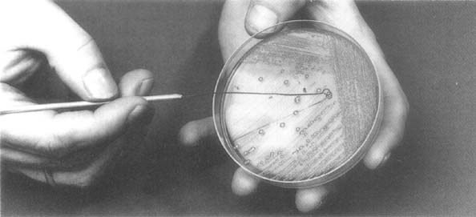
Procedure
To prepare the inoculum from the primary culture plate, touch with a loop the tops of each of 3 - 5 colonies, of similar appearance, of the organism to be tested
From pure culture, a loopful of the confluent growth is similarly suspended in saline

Slide 44
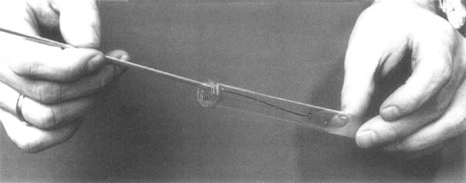
Dilution
Transfer to a tube of saline

Slide 45

Compare the tube with the turbidity standard and adjust the density of the test suspension to that of the standard by adding more bacteria or more sterile saline

Slide 46
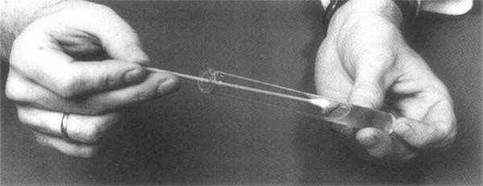
Inoculating the plate
Inoculate the plates by dipping a sterile swab into the inoculum.
Remove excess inoculum by pressing and rotating the swab firmly against the side of the tube above the level of the liquid

Slide 47
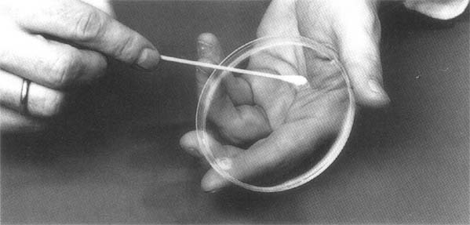
Streak the swab all over the surface of the medium three times, rotating the plate through an angle of 60 ° after each application. Finally, pass the swab round the edge of the agar surface. Leave the inoculum to dry for a few minutes at room temperature with the lid closed.

Slide 48
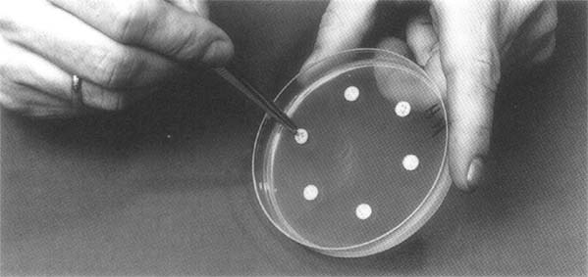
Placing the antobioticc
The antibiotic discs may be placed on the inoculated plates using a pair of sterile forceps.
Or needle tip.

Slide 49
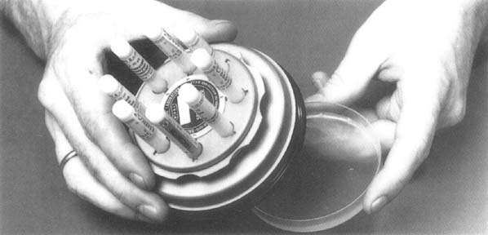
Antibiotic disc dispenser can be used to apply the discs to the inoculated plate.

Slide 50
Disc spacing
A maximum of seven discs can be placed on a 9-10 cm plate.
Six discs may be spaced evenly, approximately 15 mm from the edge of the plate, and 1 disc placed in the centre of the plate.
Each disc should be gently pressed down to ensure even contact with the medium

Slide 51
The plates should be placed in an incubator at 35 °C within 30 minutes of preparation
After overnight incubation, the diameter of each zone (including the diameter of the disc) should be measured and recorded in mm.
The results should then be interpreted according to the critical diameters.
The measurements can be made with a ruler on the under-surface of the plate without opening the lid.

Slide 52
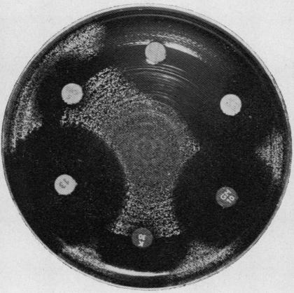

Slide 53
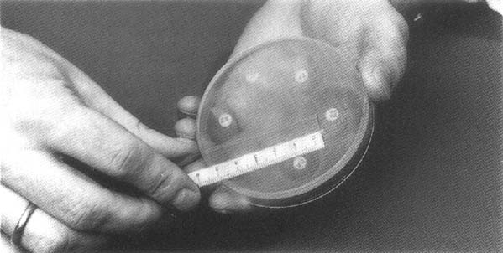
Measuring with a ruler

Slide 54
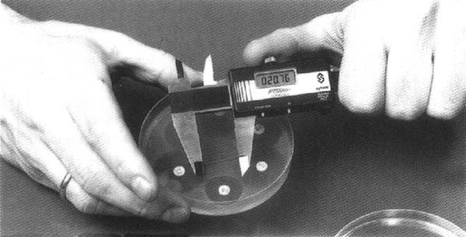
If the medium is opaque, the zone can be measured by means of a pair of calipers.

Slide 55
Enterobacteriaceae: Revised Breakpoints for Cephalosporins
Agent | CLSI 2009 |  |  | CLSI 2010
 | S | I | R | S | I | R
Cefazolin | ≤8 | 16 | ≥32 | ≤1 | 2 | ≥4
Cefotaxime | ≤8 | 16-32 | ≥64 | ≤1 | 2 | ≥4
Ceftriaxone | ≤8 | 16-32 | ≥64 | ≤1 | 2 | ≥4
Ceftazidime | ≤8 | 16 | ≥32 | ≤4 | 8 | ≥16
Aztreonam | ≤8 | 16 | ≥32 | ≤4 | 8 | ≥16
Cefipime | ≤8 | 16 | ≥32 | ≤8 | 16 | ≥32

Slide 56
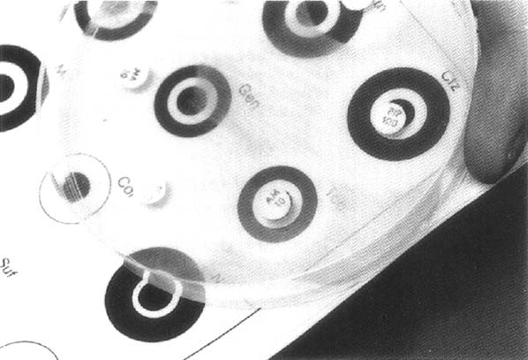
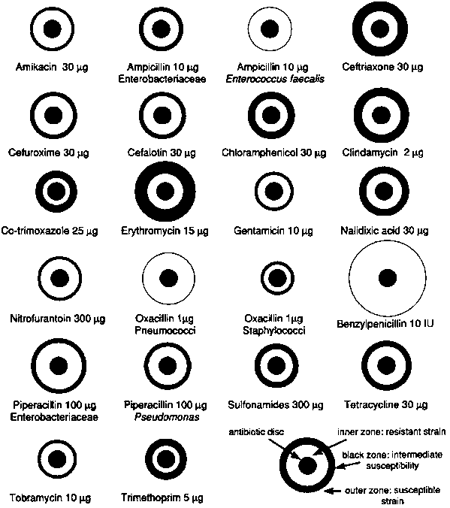
A template may be used to assess the final result of the susceptibility tests.

Slide 57
With sulfonamides and co-trimoxazole, slight growth occurs within the inhibition zone; such growth should be ignored.
When β-lactamase-producing staphylococci are tested against penicillin, zones of inhibition are produced with a heaped-up, clearly defined edge; these are readily recognizable when compared with the sensitive control, and regardless of size of zone of inhibition, they should be reported as resistant.
• Certain Proteus species may swarm into the area of inhibition around some antibiotics, but the zone of inhibition is usually clearly outlined and the thin layer of swarming growth should be ignored.

Slide 58
Interpretative zones
Interpretative chart of zone sizesª
 | Diameter of zone of inhibition (mm)
Antibiotic or chemotherapeutic agent | Disc potency | Resistant | Intermediate/ moderately susceptible | Susceptible
amikacin | 30 μg | ≤ 14 | 15-16 | ≥ 17
ampicillin when testing:
- Enterobacteriaceae | 10 μg | ≤ 13 | 14-16 | ≥ 17
- Enterococcus faecalis | 10 μg | ≤ 16 | - | ≥ 17
Interpretative chart of zone sizesª

Slide 59
Interpretative zones
Interpretative chart of zone sizesª
 | Diameter of zone of inhibition (mm)
Antibiotic or chemotherapeutic agent | Disc potency | Resistant | Intermediate moderately susceptible | Susceptible
benzylpenicillin when testing staphylococci | 10 IU | ≤ 28 | - | ≥ 29
ceftriaxone | 30 μg | ≤ 13 | 14-20 | ≥ 21
cefuroxime sodium | 30 μg | ≤ 14 | 15-17 | ≥ 18
cefalotin | 30 μg | ≤ 14 | 15-17 | ≥ 18
Chloramphen | 30 μg | ≤ 12 | 13-17 | ≥ 18

Slide 60
Caution
Timing of disc application
If the plates, after being seeded with the test strain, are left at room temperature for periods longer than the standard time, multiplication of the inoculum may take place before the discs are applied. This causes a reduction in the zone diameter and may result in a susceptible strain being reported as resistant

Slide 61
Caution
Temperature of incubation
Susceptibility tests are normally incubated at 35 °C for optimal growth. If the temperature is lowered, the time required for effective growth is extended and larger zones result

Slide 62
Caution
Temperature of incubation
Susceptibility tests are normally incubated at 35 °C for optimal growth.
If the temperature is lowered, the time required for effective growth is extended and larger zones result.

Slide 63
Caution
Incubation time
Most techniques adopt an incubation period of between 16 and 18 hours.
In emergencies, report may be made after 6 hours. This is not recommended as a routine and the result should always be confirmed after the conventional incubation time.

Slide 64
caution
Size of plate, depth of agar medium, and spacing of the antibiotic discs
Susceptibility tests are usually carried out with 9 - 10 cm plates and no more than 6 or 7 antibiotic discs on each plate.
If larger numbers of antibiotics have to be tested, two plates, or one 14-cm diameter plate, is to be preferred.

Slide 65
Cautions
Excessively large inhibition zones may be formed on very thin media; the converse is true for thick media. Minor changes in the depth of the agar layer have negligible effect. Proper spacing of the discs is essential to avoid overlapping of the inhibition zones or deformation near the edge of the plates.

Slide 66
Caution
Potency of the antibiotic discs
The diameter of the inhibition zone is related to the amount of drug in the disc.
If the potency of the drug is reduced owing to deterioration during storage, the inhibition zone will show a corresponding reduction in size.

Slide 67
Caution
Composition of the medium
The medium influences the size of the zone by its effect on the rate of growth of the organism, the rate of diffusion of the antibiotic, and the activity of the agent.
It is essential to use the medium appropriate to the particular method.

Slide 68
Final caution-
The many factors influencing the zone diameters that may be obtained for the same test organism clearly demonstrate the need for standardization of disc diffusion methods.

Slide 69
Overcoming the problems
The precision and accuracy of the method should be monitored by establishing the quality control programme

Slide 70
Quality control
Need for quality control in the susceptibility test
Factors, such as the inoculum density and the incubation temperature, are easy to control, but a laboratory rarely knows the exact composition of a commercial medium or the batch-to-batch variations in its quality, and it cannot take for granted the antimicrobial content of the discs. The results of the test must therefore be monitored constantly by a quality control programme, which should be considered part of the procedure itself.

Slide 71
Control
The precision and accuracy of the test are controlled by the parallel use of a set of control strains, with known susceptibility to the antimicrobial agents.
The quality control strains are tested using exactly the same procedure as for the test organisms.

Slide 72
Standard procedure for quality control
The quality control programme should use standard reference strains of bacteria that are tested in parallel with the clinical cultures. They should preferably be run every week, or with every fifth batch of tests, and, in addition, every time that a new batch of Mueller-Hinton agar or a new batch of discs is used.

Slide 73
Standard strains for quality control
Staphylococcus aureus (ATCC 25923) Escherichia coli (ATCC 25922) Pseudomonas aeruginosa (ATCC 27853)

Slide 74
Control strains
These can be obtained from National culture collections.
They are commercially available in the form of pellets of desiccated pure cultures.
Cultures for day-to-day use should be grown on slants of nutrient agar (tryptic soy agar is convenient) and stored in the refrigerator.
Remember: Subcultured on to fresh slants every 2 weeks.

Slide 75
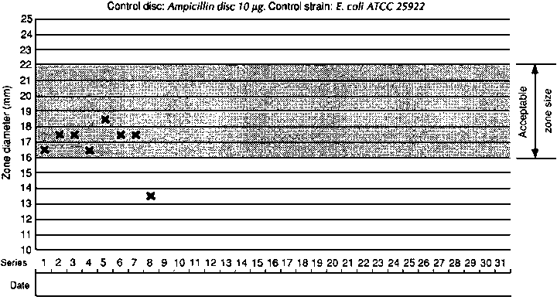
Recording quality results

Slide 76

What are ESBL producing bacteria.
The term ESBLs is used to mean acquired, class A β-lactamases that hydrolyze and confer resistance to oxyimino- ‘2nd- and 3rd-generation’ cephalosporins, eg cefuroxime, cefotaxime, ceftazidime and ceftriaxone

Slide 77
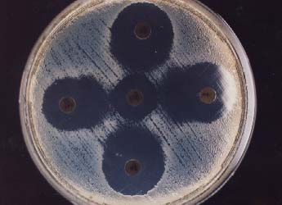
Further complicating matters:
More than one gene of β-lactamase / ESBL / ampC / carbapenemase can be carried on the same plasmid.
Genes of ESBL are carried on plasmids that usually carry additional resistant genes: frequently MDR
Laboratory diagnosis confusing:
susceptibility profiles sometimes
misleading: “hidden resistance” ->
CLSI guidelines are changing.
CTX-M clones appearing in the
community (Canada, Greece, Spain,
Italy).

Slide 78
ESBLs include:
Cephalosporin-hydrolysing mutants of TEM and SHV - the common plasmid-mediated penicillinases of Enterobacteriaceae. Well over 100 such variants are known
• CTX-M types. These evolved separately, at least some of them via the escape and mutation of chromosomal β-lactamases of Kluyvera species. Over 30 variants are known Obscure types, e.g. VEB and PER, not yet of concern in the UK; also OXA (Class D) ESBLs from Pseudomonas aeruginosa, in Turkey.

Slide 79
They should be distinguished from other important modes of resistance to 2nd and 3rd generation cephalosporins, eg:
Hyper produced chromosomal AmpC β-lactamases, especially in Enterobacter species.
• Plasmid-mediated AmpC β-lactamases, in Klebsiella spp. and E. coli (rare)
• Hyper produced K1 chromosomal β-lactamases in K. oxytoca not pneumoniae)
• Efflux-mediated resistance in P. aeruginosa
• Various ill-defined mechanisms in Acinetobacter species.

Slide 80
SCREENING
The ideal indicator cephalosporin is one to which all ESBLs confer resistance, even when their production is scanty. Choice is predicated by the following general traits:
TEM and SHV ESBLs – obvious resistance to ceftazidime, variable to cefotaxime
CTX-M ESBLs – obvious resistance to cefotaxime: variable to ceftazidime
All ESBLs – obvious resistance to cefpodoxime

Slide 81
What is Minimum Inhibitory concentration
Minimum inhibitory concentration (MIC), in microbiology, is the lowest concentration of an antimicrobial that will inhibit the visible growth of a micro organism after overnight incubation. Minimum inhibitory concentrations are important in diagnostic laboratories to confirm resistance of micro organisms to an antimicrobial agent and also to monitor the activity of new antimicrobial agents.[
pkfeglo

Slide 82
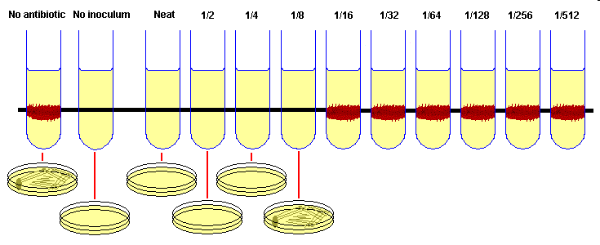
The Antibiotics are diluted to various dilution to test the minimum inhibitory concentration

Slide 83
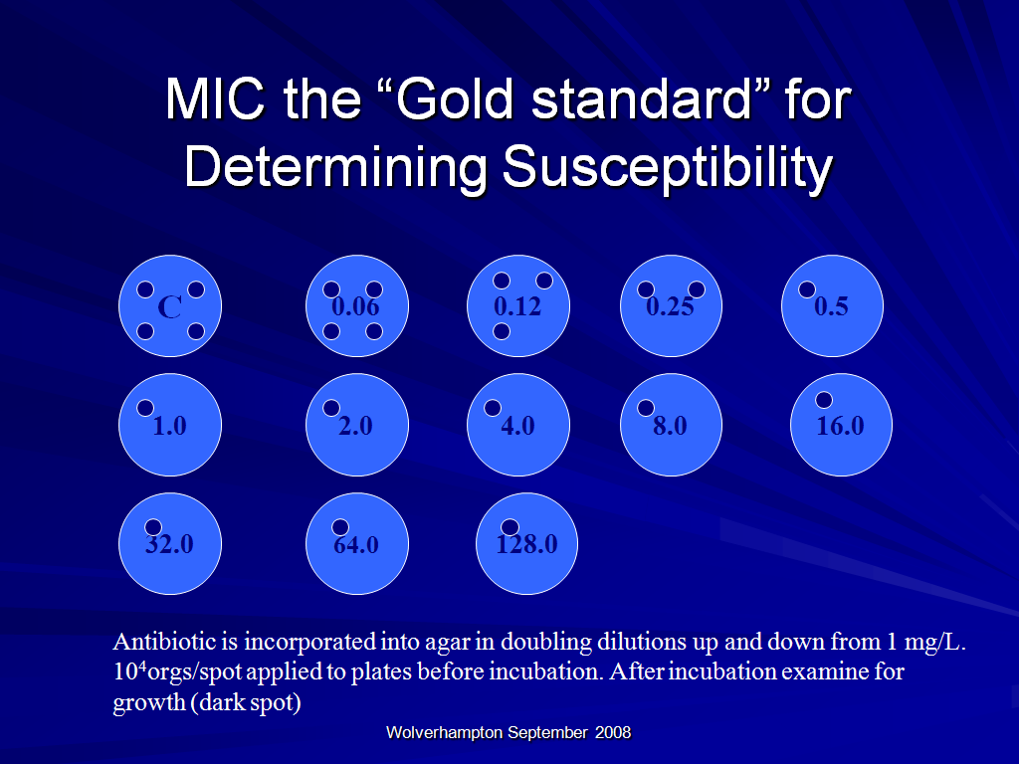
Notes:
The MIC is the lowest concentration of the antimicrobial required to inhibit growth of the organism.
Quantitative activity
The “gold standard” (not gradient methods)
Required for certain serious infections
endocarditis, pneumocococcal meningitis
Used for slow-growing organisms
􀁻It is used to determine the quantitative activity of an antimicrobial.
􀁻It is used to confirm resistance or equivocal results.
􀁻It is used in cases of prolonged treatment or endocarditis to adjust the dose of therapy.
􀁻It is used to determine the susceptibility of slow-growing organisms e.g anaerobes.
83

Slide 84
What is E Test
Etest is an antimicrobial gradient technique in which 15 reference MIC dilutions of an antibiotic have been repackaged with innovative dry chemistry technology onto a plastic strip. The predefined gradient provides precise and accurate assessment of antimicrobial activity against both fastidious and non-fastidious microorganisms.
PK feglo

Slide 85
Detection Strategy: step 1
Screen Enterobacteriaceae with :
Cefpodoxime- best general ESBL substrate
Cefotaxime & ceftazidime- good substrates for CTX-M & TEM/SHV, respectively
Spread of CTX-M into community means screening must be wider than before
See http://www.hpa.org.uk

Slide 86
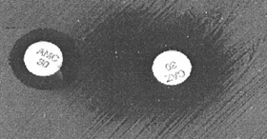
ESBL Confirmatory Tests
Double-disk synergy (DDS) test
CAZ and CAZ/CA disks
CTX and CTX\CA disks
Confirmatory testing
requires using both CAZ
and CTX alone and with CA
5 mm enhancement of the inhibition
zone of antibiotic/CA combination vs antibiotic
tested alone = ESBL

Slide 87
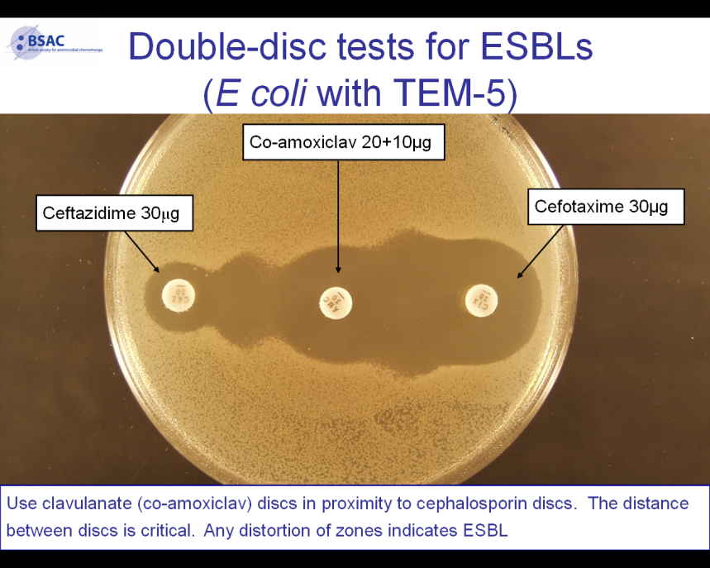

Slide 88
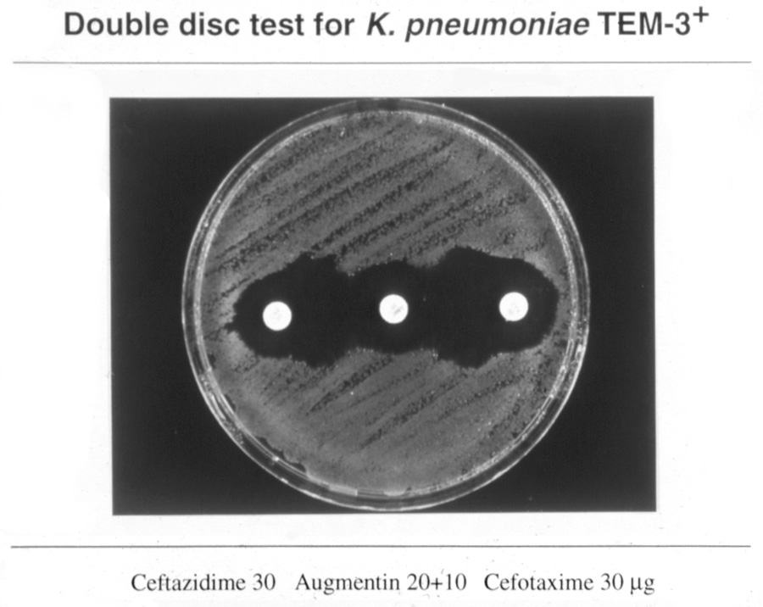

Slide 89
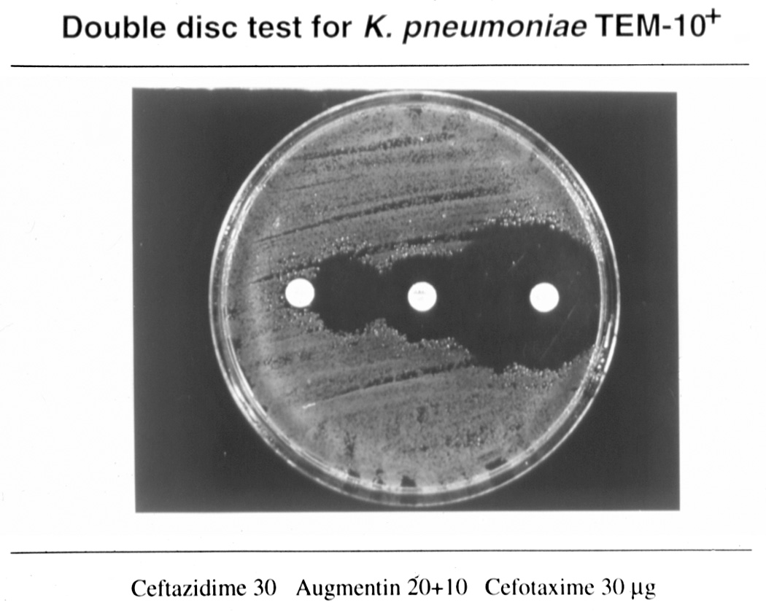

Slide 90
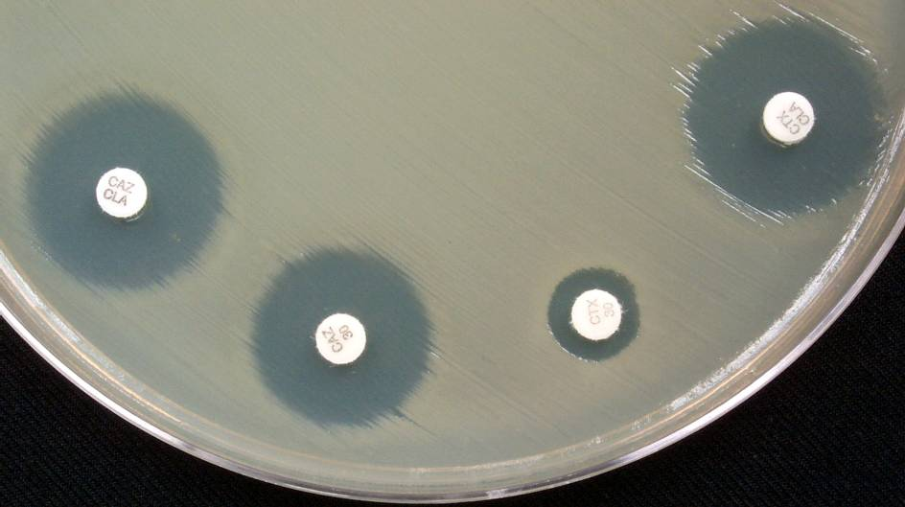
ESBL Confirmatory Test
Positive for ESBL
Cefotax/CA
Ceftaz/CA
Ceftaz
Cefotax
90

Slide 91
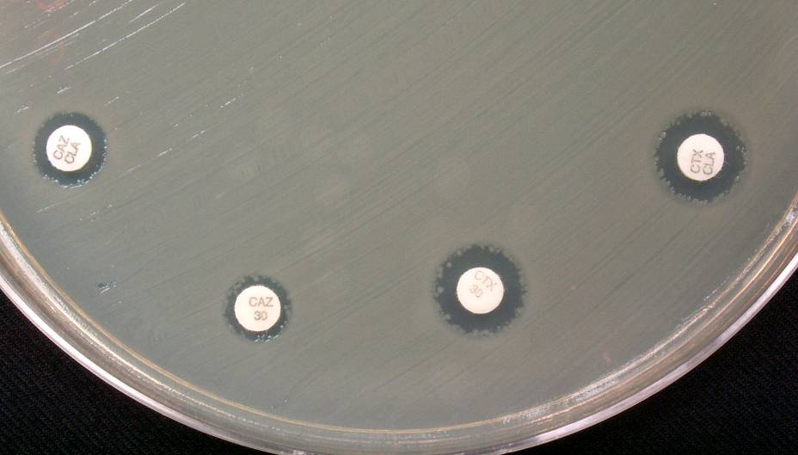
ESBL Confirmatory Test Negative for ESBL
Ceftaz/CA
Cefotaxime/CA
Ceftaz
Cefotax
91

Slide 92
What is E Test
Etest is an antimicrobial gradient technique in which 15 reference MIC dilutions of an antibiotic have been repackaged with innovative dry chemistry technology onto a plastic strip. The predefined gradient provides precise and accurate assessment of antimicrobial activity against both fastidious and non-fastidious microorganisms.
PK feglo

Slide 93
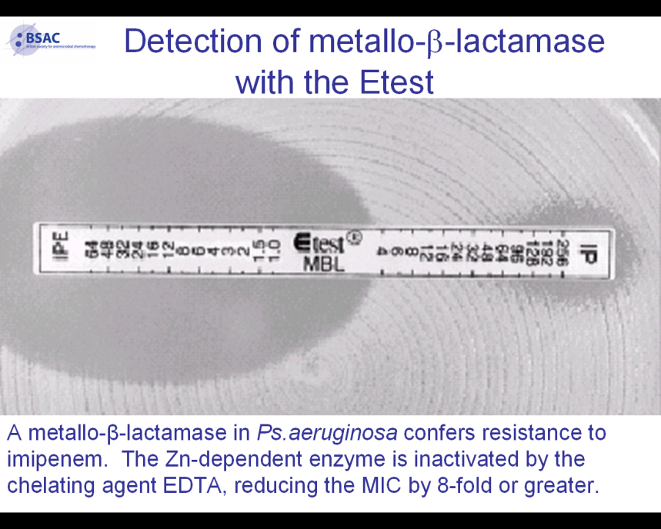

Slide 94
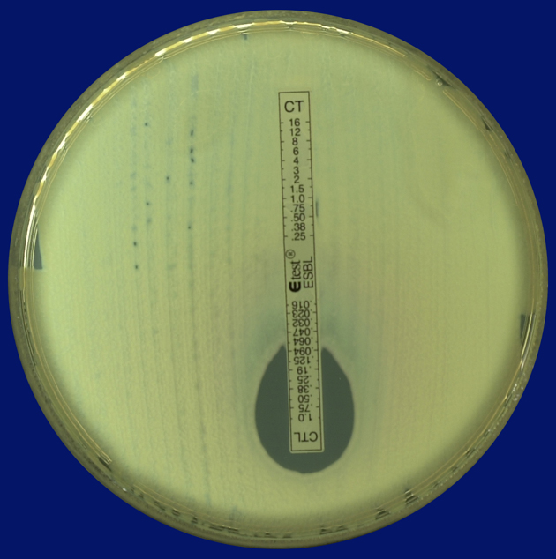
Etest for ESBLs
Cefotaxime
Cefotaxime
+
clavulanate

Slide 95
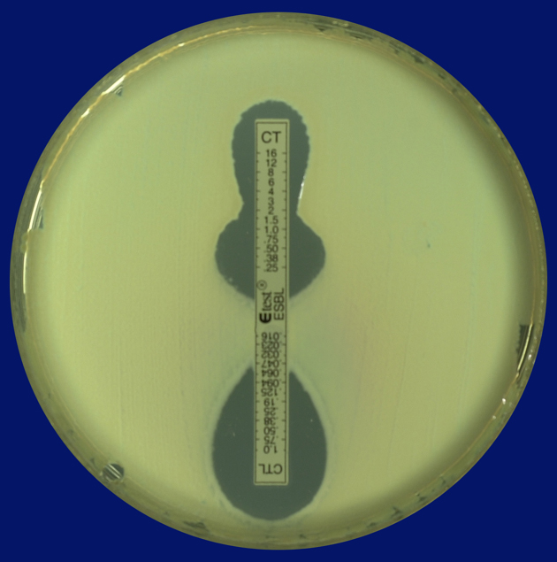
Etest for ESBLs
Cefotaxime
Cefotaxime
+
clavulanate

Slide 96
THANK YOU

